Slide 1
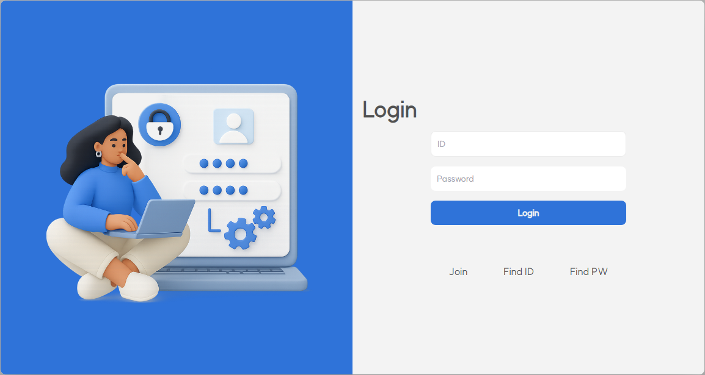
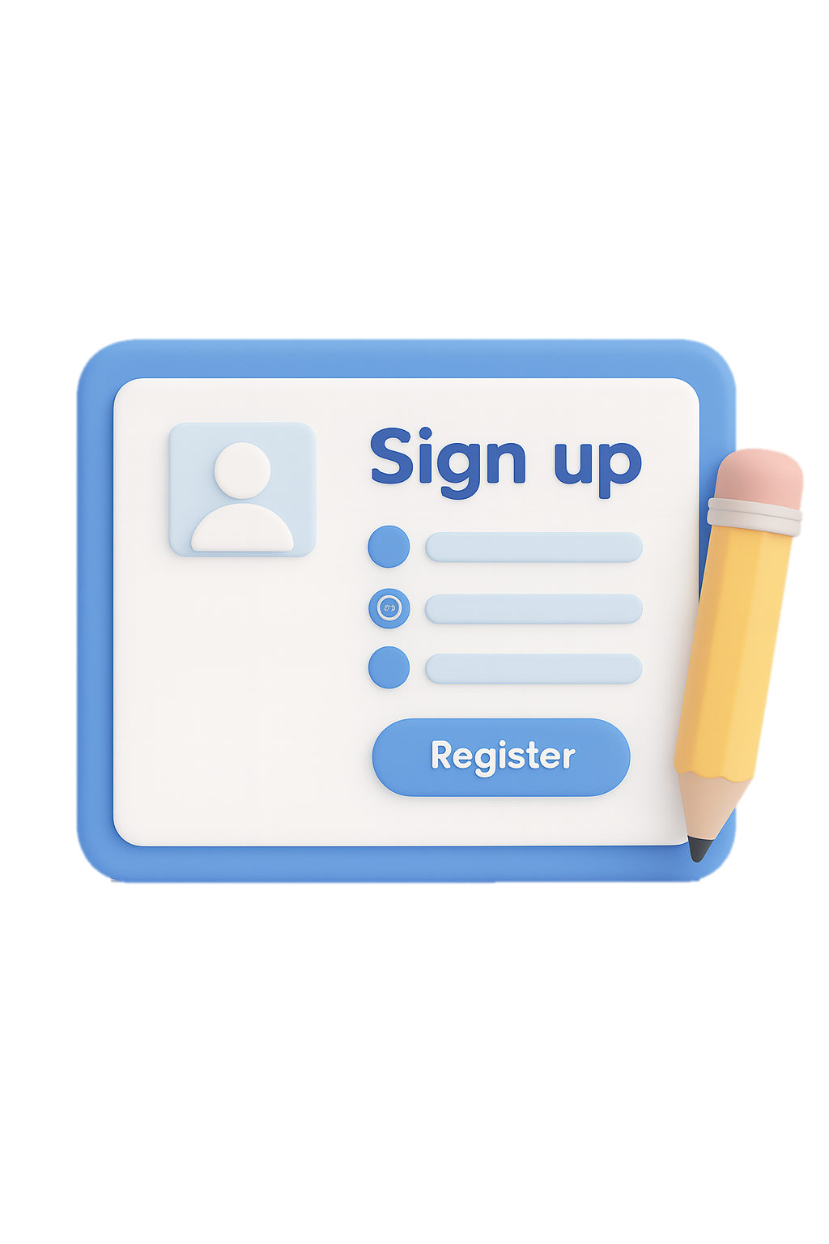


SIGN
IN
SIGN UP

Slide 2

SIGN UP
UP
SIGN
IN

Slide 3
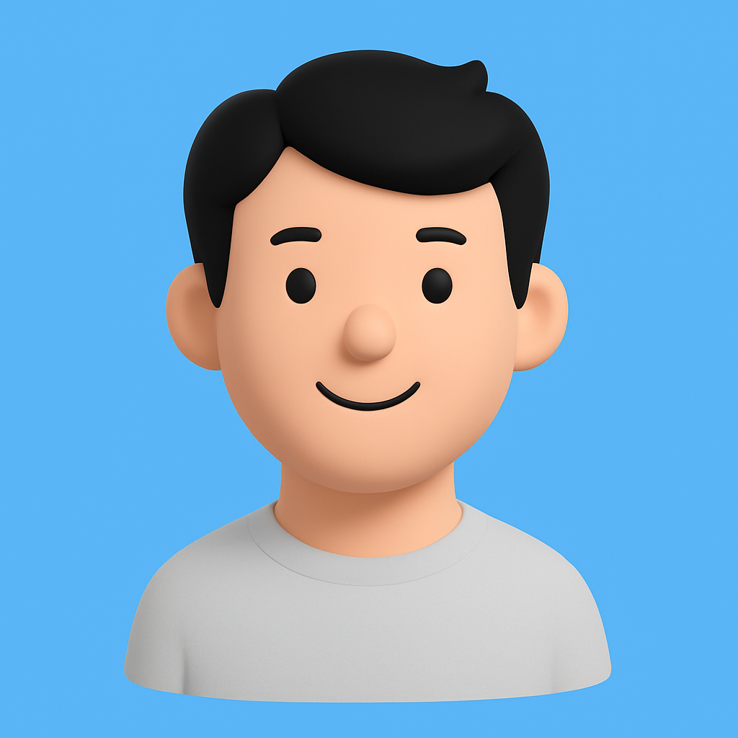

CERTIFY

Slide 4
CERTIFY
HUB
WALLET
WORK BOOK
COMMUNITY

Slide 5


